Slide 1
Queues Lecture 5

Slide 2
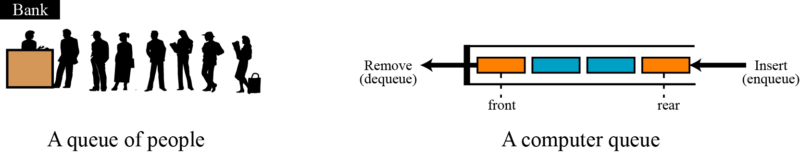
Queues
What is a queue?
A data structure of ordered items such that items can be inserted only at one end and removed at the other end.
A queue is called a FIFO (First in-First out) data structure.
Insertions and deletions follow the first-in first-out scheme.
Insertions are at the rear of the queue and removals are at the front of the queue.
Two representations of queues

Slide 3
Queues( First-In-First-Out (FIFO) list)
Queue
An ordered list
All insertions take place at one end, rear
All deletions take place at the opposite end, front
Illustration
$ $
Rear
Front
A
B
A
C
B
A
D
C
B
A
rear
front
D
C
B
rear
front
rear
rear
front
rear
front
front

Slide 4
Application: Job scheduling
Insertion and deletion from a sequential queue
Notes:
Another common application of a queue is to adjust and create a balance between a fast producer of data and a slow consumer of data. For example, assume that a CPU is connected to a printer. The speed of a printer is not comparable with the speed of a CPU. If the CPU waits for the printer to print some data created by the CPU, the CPU would be idle for a long time. The solution is a queue. The CPU creates as many chunks of data as the queue can hold and sends them to the queue. The CPU is now free to do other jobs. The chunks are dequeued slowly and printed by the printer. The queue used for this purpose is normally referred to as a spool queue.

Slide 5
Applications of Queues
Direct applications
Waiting lines
Round-robin scheduling in processors
Input/Output processing
Queueing of packets for delivery in networks
Access to shared resources (e.g., printer)
Multiprogramming
All types of customer service software (like Railway/Air ticket reservation) are designed using queue to give proper service to the customers.
Indirect applications
Auxiliary data structure for algorithms
Component of other data structures

Slide 6
Main Queue Operations
Main Queue Operations
enqueue(object): inserts an element at the end of the queue
object dequeue(): removes and returns the element at the front of the queue
Auxiliary queue operations:
object front(): returns the element at the front without removing it
integer size(): returns the number of elements stored
boolean isEmpty(): indicates whether no elements are stored
Exceptions
Attempting the execution of dequeue or front on an empty queue throws an EmptyQueueException.

Slide 7
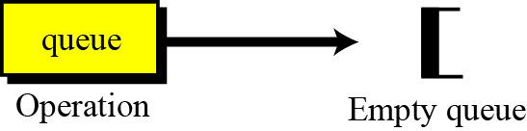
Operations on queues
Although we can define many operations for a queue, four are basic: queue, enqueue, dequeue and empty, as defined below.
The queue operation
The queue operation creates an empty queue. The following shows the format.
The queue operation

Slide 8

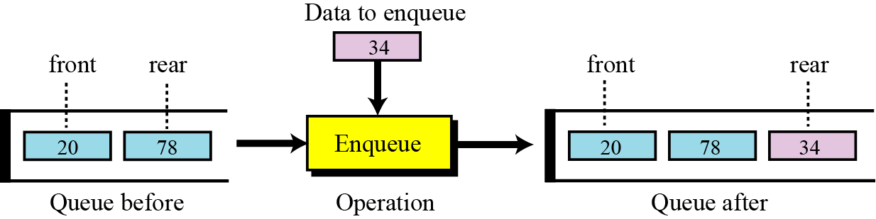
The enqueue operation
The enqueue operation inserts an item at the rear of the queue. The following shows the format.
$ $
Front
Rear
The enqueue operation

Slide 9
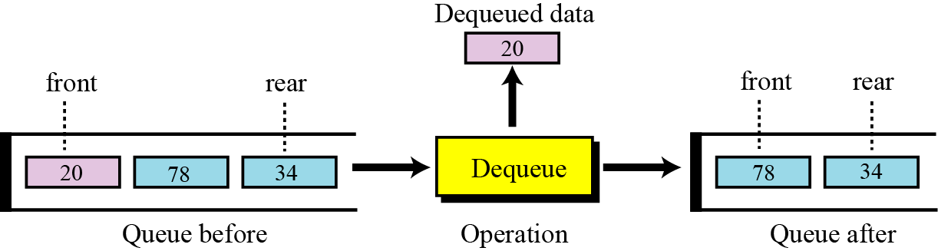
The dequeue operation
The dequeue operation deletes the item at the front of the queue. The following shows the format.
$ $
Front
Rear
The dequeue operation

Slide 10
The empty operation
The empty operation checks the status of the queue. The following shows the format.
This operation returns true if the queue is empty and false if the queue is not empty.

Slide 11
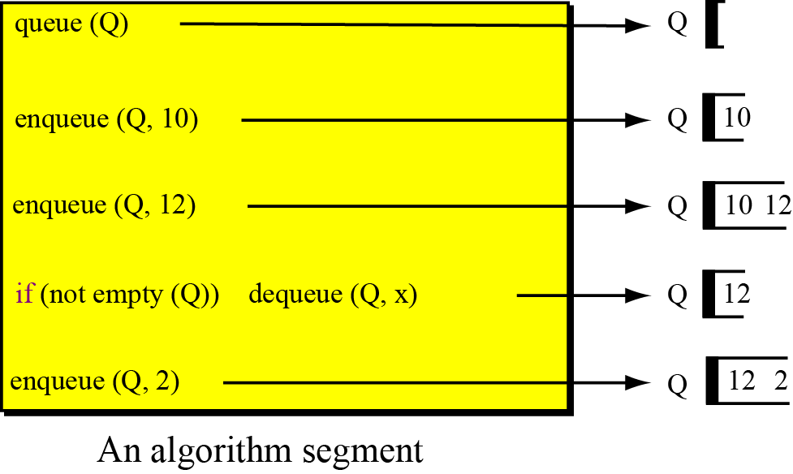
Example
A segment of an algorithm that applies the previously defined operations on a queue Q.

Slide 12
Implementing a Queue
Just like a stack, we can implement a queue in two ways:
Using an array
Using a linked list

Slide 13
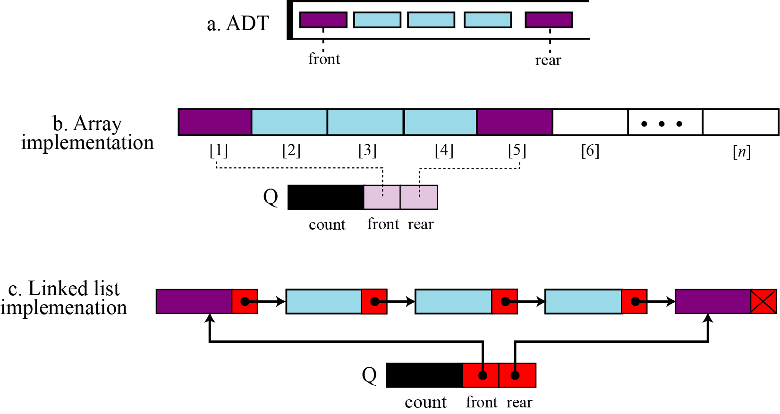
Implementing a Queue

Slide 14
Implementing a Queue
Using an array to implement a queue is significantly harder than using an array to implement a stack. Why?
Unlike a stack, where we add and remove at the same end, in a queue we add to one end and remove from the other.

Slide 15
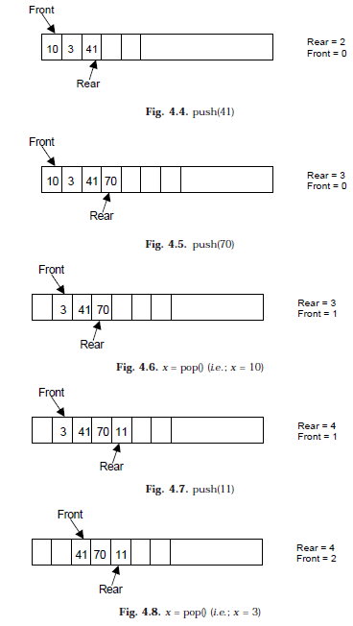
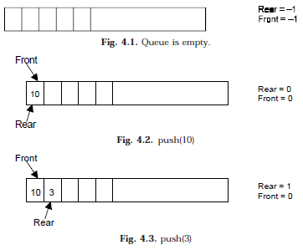
Example(Array Implementation)

Slide 16
Implementation Array-based Queue
Use an array of size N in a circular fashion
Two variables keep track of the front and rear
f index of the front element
r index immediately past the rear element
Array location r is kept empty
normal configuration
Q
0
1
2
f
r

Slide 17
Array implementation of queues
0 1 2 3 4 5 6 7
myQueue:
17
23
97
44
front = 0
rear = 3
To insert: put new element in location 4, and set rear to 4
To delete: take element from location 0, and set front to 1

Slide 18
Array implementation of queues
front = 0
rear = 3
Initial queue:
17
23
97
44
After insertion:
17
23
97
44
333
After deletion:
23
97
44
333
front = 1
rear = 4
Notice how the array contents “crawl” to the right as elements are inserted and deleted
This will be a problem after a while!

Slide 19
Circular arrays
We can treat the array holding the queue elements as circular (joined at the ends)
0 1 2 3 4 5 6 7
myQueue:
44
55
11
22
33
rear = 1
front = 5
Elements were added to this queue in the order 11, 22, 33, 44, 55, and will be removed in the same order
Use: front = (front + 1) % myQueue.length; and: rear = (rear + 1) % myQueue.length;

Slide 20
INSERTING AN ELEMENT INTO THE QUEUE
If queue is empty; Initialize front=0
Input the value to be inserted and assign to variable “data”
If (rear >= SIZE)
(a) Display “Queue overflow”
(b) Exit
Else
(a) Rear = rear +1
Q[rear] = data
Exit

Slide 21
PROGRAM TO INSERT AN ELEMENT INTO THE QUEUE
//This function will insert an element to the queue
void insert ()
{
int added_item;
if (rear==MAX-1)
{
printf("\nQueue Overflow\n");
getch();
return;
}
else
{
if (front==–1) /*If queue is initially empty */
front=0;
printf(“\nInput the element for adding in queue: ”);
scanf(“%d”, &added_item);
rear=rear+1;
//Inserting the element
queue_arr[rear] = added_item ;
}
}/*End of insert()*/

Slide 22
ALGORITHM TO DELETE AN ELEMENT FROM QUEUE
If (rear< front or front=-1)
(a) for e.g. Front = -1, rear = –1
(b) Display “The queue is empty”
(c) Exit
2. Else
(a) Data = Q[front]
3. Front = front +1
4. Exit

Slide 23
PROGRAM TO DELETE AN ELEMENT FROM QUEUE
//This function will delete (or pop) an element from the queue
void del()
{
if (front == –1 || front > rear)
{
printf ("\nQueue Underflow\n");
return;
}
else
{ //deleteing the element
printf ("\nElement deleted from queue is : %d\n",
queue_arr[front]);
front=front+1;
}
}/*End of del()*/

Slide 24
PROGRAM TO DISPLAY ALL QUEUE ELEMENTS
//Displaying all the elements of the queue
void display()
{
int i;
if (front == –1 || front > rear) //Checking whether the queue is empty or not
{
printf (“\nQueue is empty\n”);
return;
}
else
{
printf(“\nQueue is :\n”);
for(i=front;i<= rear;i++)
printf(“%d ”,queue_arr[i]);
printf(“\n”);
}
}/*End of display() */

Slide 25
Linked-list implementation of queues
In a queue, insertions occur at one end, deletions at the other end
Operations at the front of a singly-linked list (SLL) are O(1), but at the other end they are O(n)
Because you have to find the last element each time
BUT: there is a simple way to use a singly-linked list to implement both insertions and deletions in O(1) time
You always need a pointer to the first element in the list
You can keep an additional pointer to the last element in the list

Slide 26
SLL implementation of queues
In an SLL you can easily find the successor of a node, but not its predecessor
Remember, pointers (references) are one-way
If you know where the last node in a list is, it’s hard to remove that node, but it’s easy to add a node after it
Hence,
Use the first element in an SLL as the front of the queue
Use the last element in an SLL as the rear of the queue
Keep pointers to both the front and the rear of the SLL

Slide 27
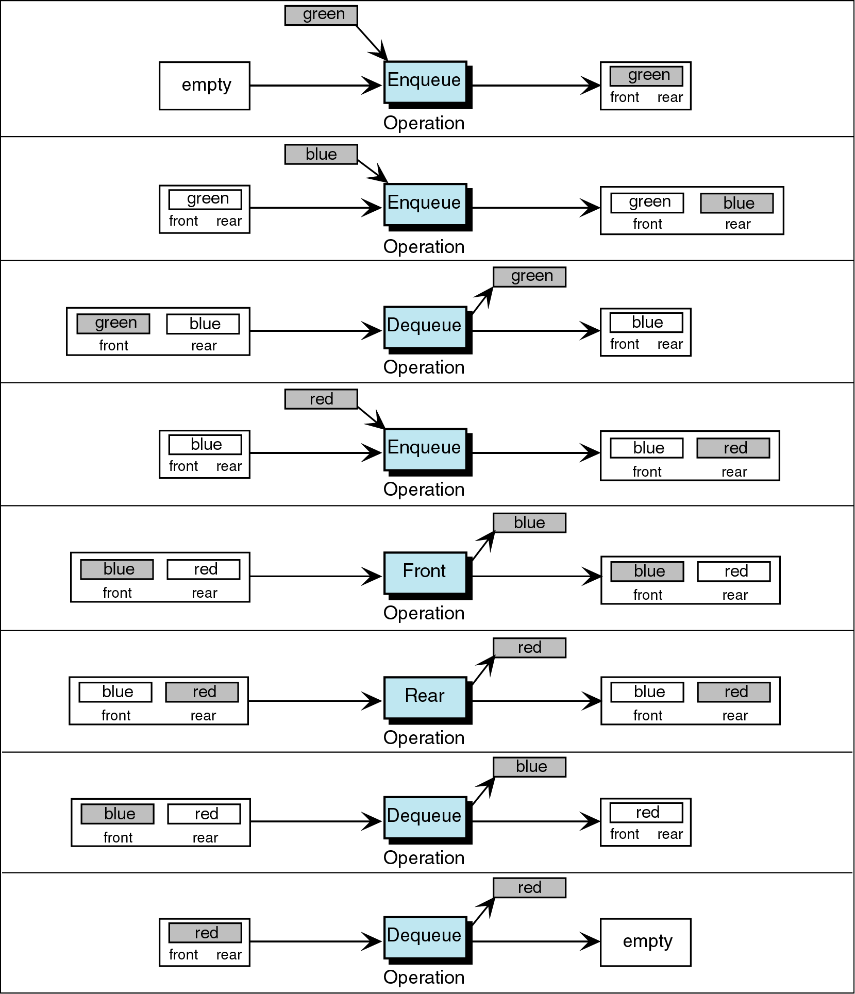
Figure 5-6

Slide 28
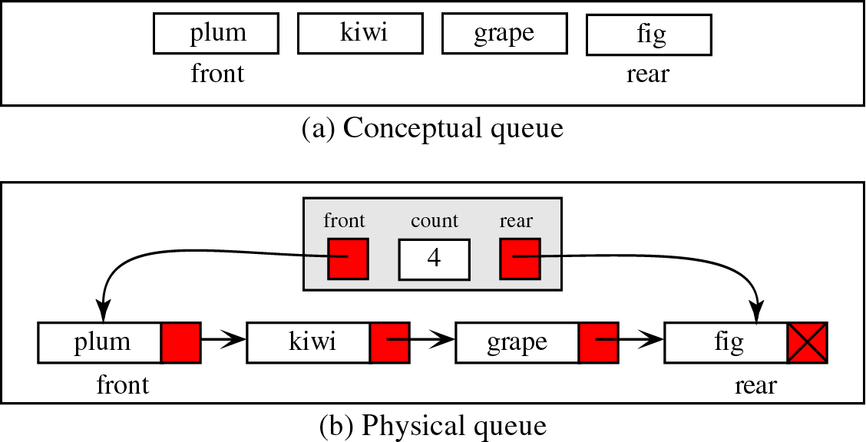
Queue Linked List Design

Slide 29
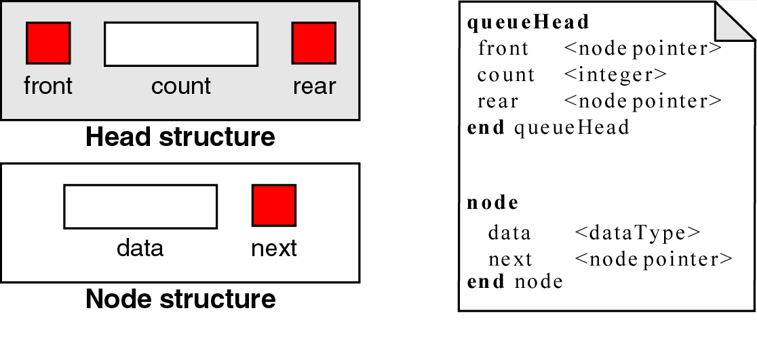
Queue Data Structure

Slide 30
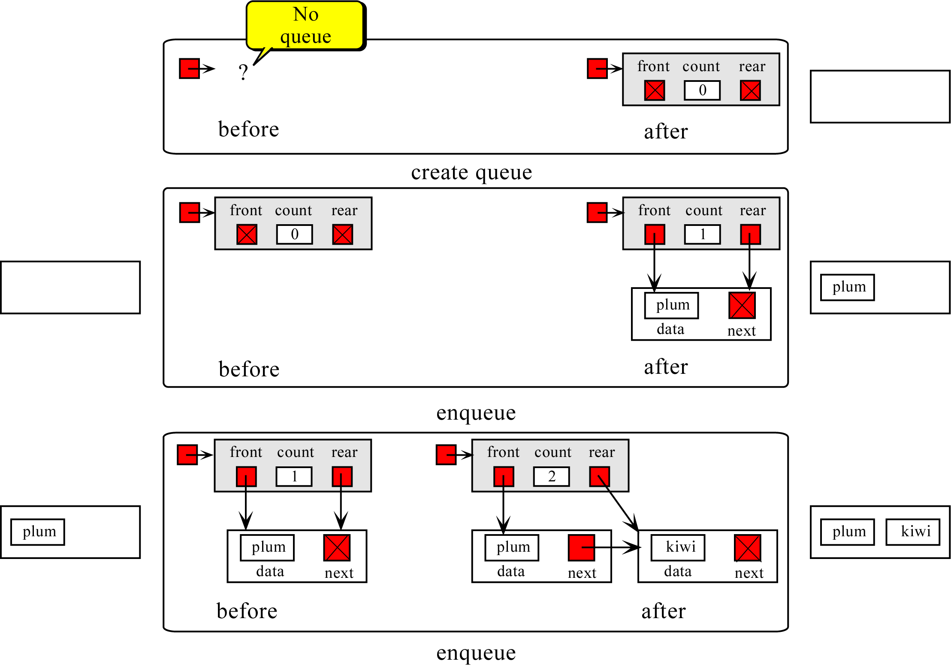

Slide 31
Queue Algorithms - Create Queue
Algorithm createQueue
Allocates memory for a queue head node from dynamic memory and returns its address to the caller.
Pre Nothing
Post head has been allocated and initialized
Return head’s address if successful, null if memory owerflow.
if (memory available)
allocate (newPtr)
newPtr→front = null pointer
newPtr→rear = null pointer
newPtr→count = 0
return newPtr
else
return null pointer
end createQueue

Slide 32
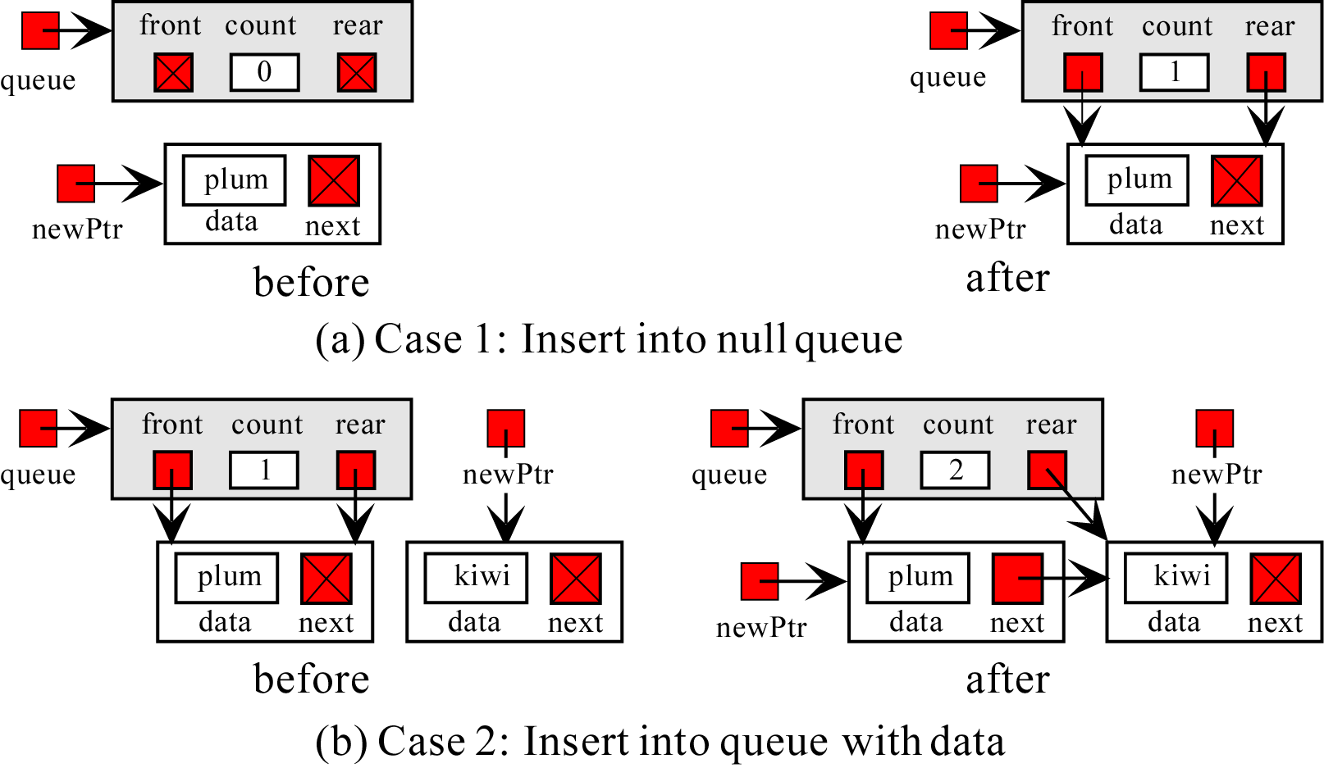
Queue Algorithms - Enqueue

Slide 33
Enqueueing a node
Node to be enqueued
last first
44
97
23
17
To enqueue (add) a node:
Find the current last node
Change it to point to the new last node
Change the last pointer in the list header

Slide 34
ALGORITHM FOR ENQUEUING AN ELEMENT TO A QUEUE
REAR is a pointer in queue where the new elements are added. FRONT is a pointer, which is pointing to the queue where the elements are popped. DATA is an element to be inserted.
1. Input the DATA element to be inserted
2. Create a New Node
3. NewNode → DATA = DATA
4. NewNode → Next = NULL
5. If(REAR not equal to NULL)
(a) REAR → next = NewNode;
6. REAR =NewNode;
7. Exit

Slide 35
PROGRAM FOR ENQUEUING AN ELEMENT TO A QUEUE
//This function will push an element into the queue
NODE push(NODE rear)
{
NODE NewNode; //New node is created to push the data
printf ("\nEnter the no to be pushed = ");
scanf ("%d",&NewNode->info);
NewNode->next=NULL;
if (rear != NULL) //setting the rear pointer
rear->next=NewNode;
rear=NewNode;
return(rear);
}

Slide 36
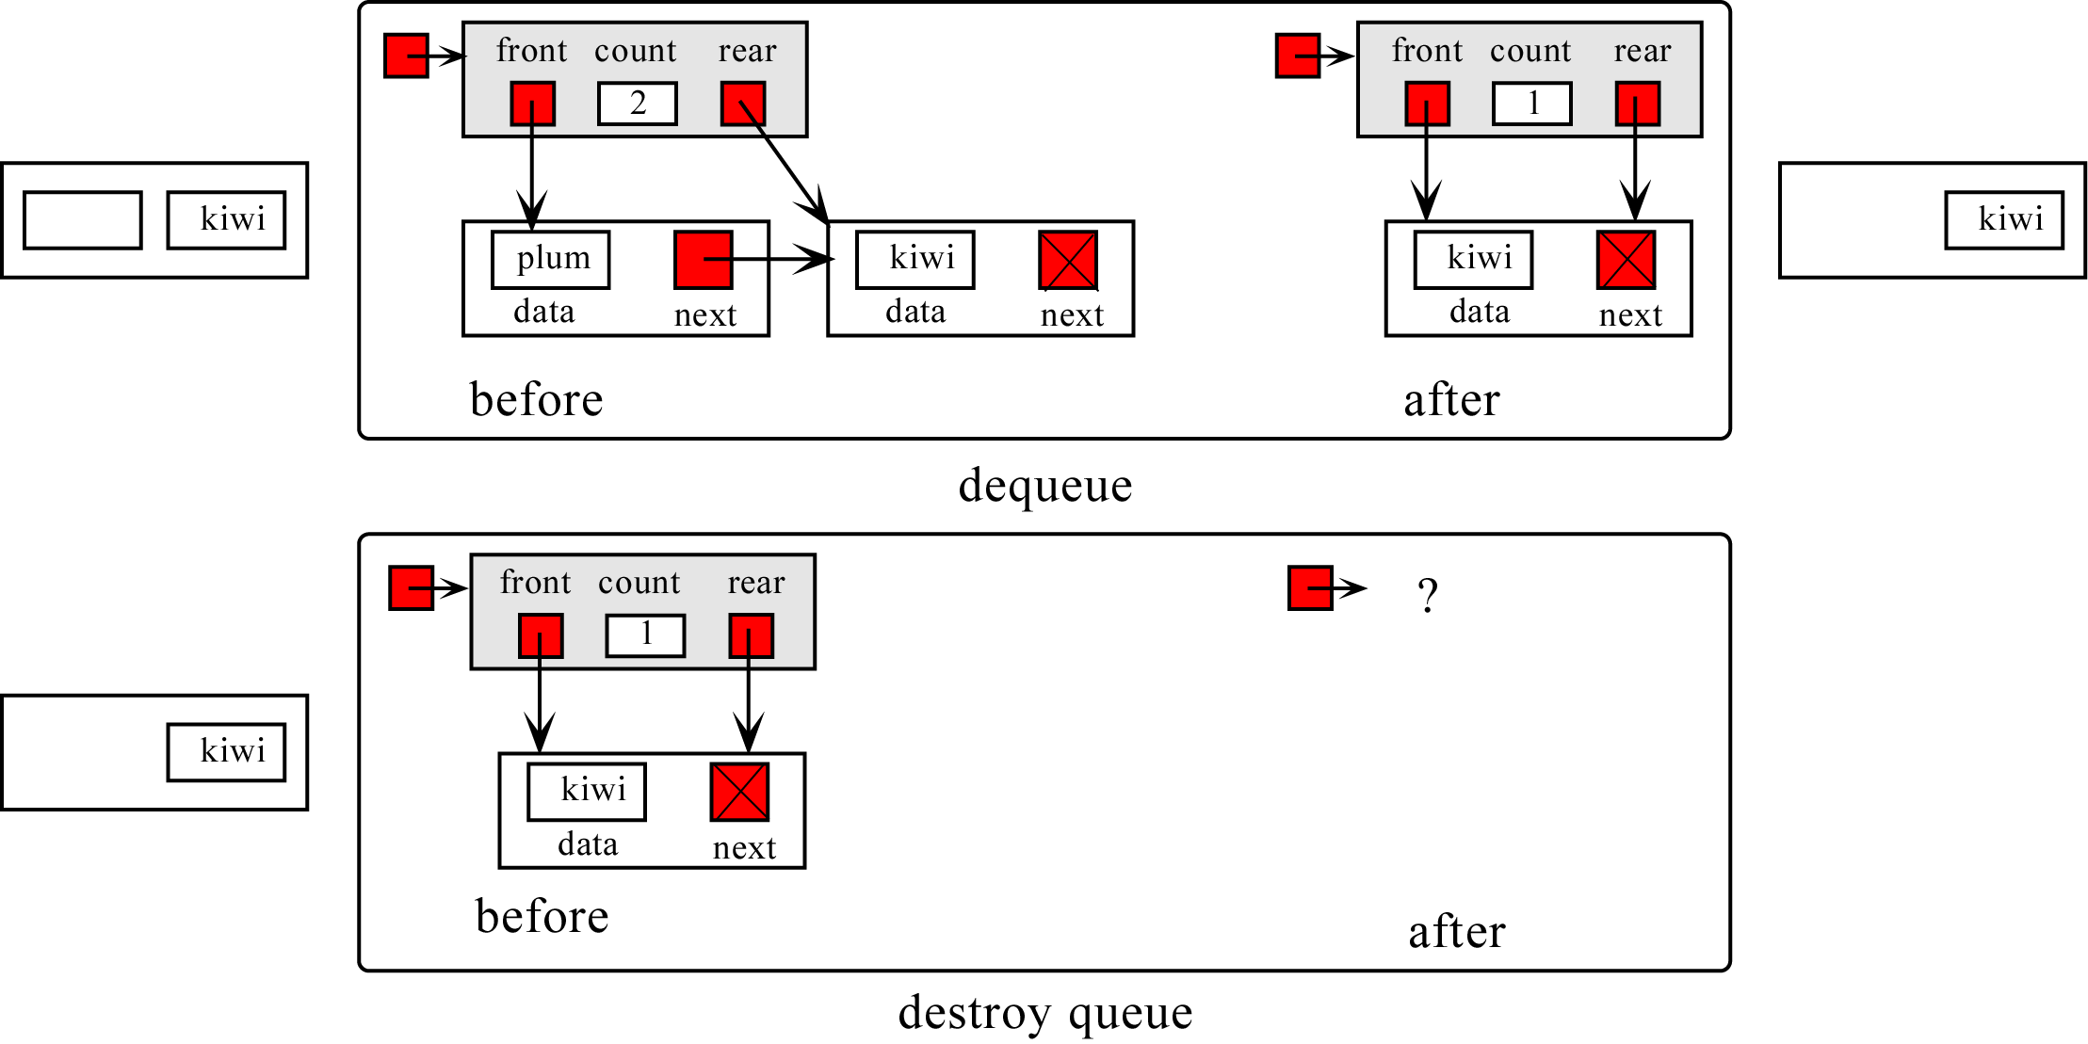
Dequeueing a node

Slide 37
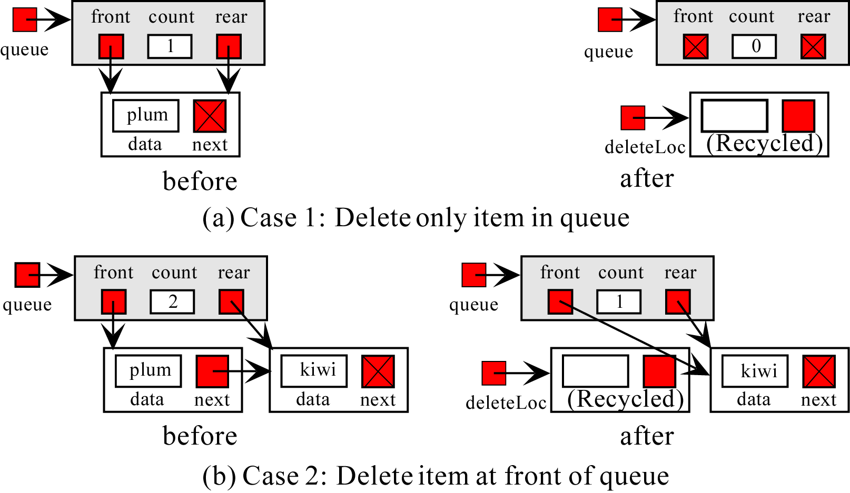
Figure 5-11

Slide 38
Dequeueing a node
last first
44
97
23
17
To dequeue (remove) a node:
Copy the pointer from the first node into the header

Slide 39
ALGORITHM FOR DEQUEUING AN ELEMENT FROM A QUEUE
REAR is a pointer in queue where the new elements are added. FRONT is a pointer, which is pointing to the queue where the elements are removed. DATA is an element popped from the queue.
1. If (FRONT is equal to NULL)
(a) Display “The Queue is empty”
2. Else
(a) Display “The popped element is FRONT → DATA”
(b) If(FRONT is not equal to REAR)
(i) FRONT = FRONT → Next
(c) Else
(d) FRONT = NULL;
3. Exit

Slide 40
OTHER QUEUES
There are three major variations in a simple queue. They are
Circular queue
Double ended queue (de-queue)
Priority queue

Slide 41
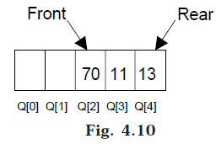
CIRCULAR QUEUE
Suppose a queue Q has maximum size 5, say 5 elements pushed and 2 elements popped.
Now if we attempt to add more elements, even though 2 queue cells are free, the elements cannot be pushed. Because in a queue, elements are always inserted at the rear end and hence rear points to last location of the queue array Q[4]. That is queue is full (overflow condition) though it is empty. This limitation can be overcome if we use circular queue.

Slide 42
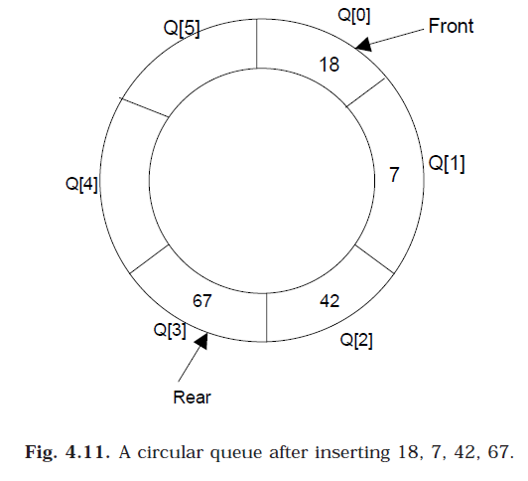
CIRCULAR QUEUE
In circular queues the elements Q[0],Q[1],Q[2] .... Q[n – 1] is represented in a circular fashion with Q[0] following Q[n-1]. A circular queue is one in which the insertion of a new element is done at the very first location of the queue if the last location at the queue is full.
Suppose Q is a queue array of 6 elements. Push and pop operation can be performed on circular. The following figures will illustrate the same.

Slide 43
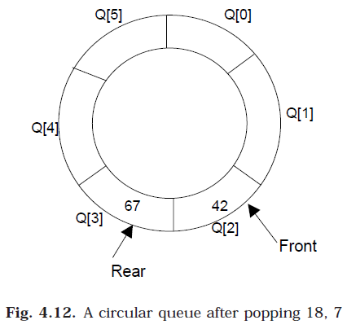
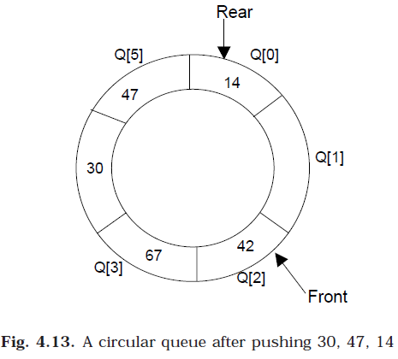
CIRCULAR QUEUE
Notes:
After inserting an element at last location Q[5], the next element will be inserted at the very first location (i.e., Q[0]) that is circular queue is one in which the first element comes just after the last element.

Slide 44
CIRCULAR QUEUE
At any time the position of the element to be inserted will be calculated by the relation Rear = (Rear + 1) % SIZE.
After deleting an element from circular queue the position of the front end is calculated by the relation Front= (Front + 1) % SIZE.
After locating the position of the new element to be inserted, rear, compare it with front. If (rear = front), the queue is full and cannot be inserted anymore.

Slide 45
Algorithm to Insert an element to circular Queue
Initialize FRONT = – 1; REAR = --1
REAR = (REAR + 1) % SIZE
If (FRONT is equal to REAR)
(a) Display “Queue is full”
(b) Exit
Else
(a) Input the value to be inserted and assign to variable “DATA”
If (FRONT is equal to – 1)
(a) FRONT = 0
(b) REAR = 0
Q[REAR] = DATA
Repeat steps 2 to 5 if we want to insert more elements
Exit

Slide 46
Program to Insert an element to circular Queue
//Function to insert an element to the circular queue
void circular_queue::insert()
{
int added_item;
if ((front == 0 && rear == MAX-1) || (front == rear +1)) //Checking for overflow condition
{
cout<<“\nQueue Overflow \n”;
getch();
return;
}
if (front == –1) /*If queue is empty */
{
front = 0;
rear = 0;
}
else
if (rear == MAX-1) //rear is at last position of queue
rear = 0;
else
rear = rear + 1;
cout<<“\nInput the element for insertion in queue:”;
cin>>added_item;
cqueue_arr[rear] = added_item;
}/*End of insert()*/

Slide 47
Algorithm to Delete an element from a circular queue
1. If (FRONT is equal to – 1)
(a) Display “Queue is empty”
(b) Exit
2. Else
(a) DATA = Q[FRONT]
3. If (REAR is equal to FRONT)
(a) FRONT = –1
(b) REAR = –1
4. Else
(a) FRONT = (FRONT +1) % SIZE
5. Repeat the steps 1, 2 and 3 if we want to delete more elements
6. Exit

Slide 48
Program to Delete an element from a circular queue
//This function will delete an element from the queue
void circular_queue::del()
{
if (front == –1) //Checking for queue underflow
{
cout<<“\nQueue Underflow\n”;
return;
}
cout<<“\nElement deleted from queue is:”<<cqueue_arr[front]<<“\n”;
if (front == rear) /* queue has only one element */
{
front = –1;
rear = –1;
}
else
if(front == MAX-1)
front = 0;
else
front = front + 1;
}/*End of del()*/

Slide 49
Queue implementation details
With an array implementation:
you can have both overflow and underflow
you should set deleted elements to null
With a linked-list implementation:
you can have underflow
overflow is a global out-of-memory condition
there is no reason to set deleted elements to null

Slide 50
Sources used
Lectures by Mr. Mohammad Asad Abbasi

